Slide 1
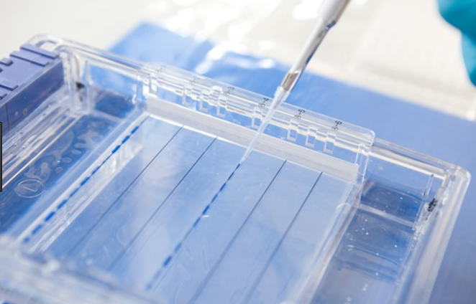
Techniques in Biotechnology
DNA Sequencing and Protein Electrophoresis

Slide 2
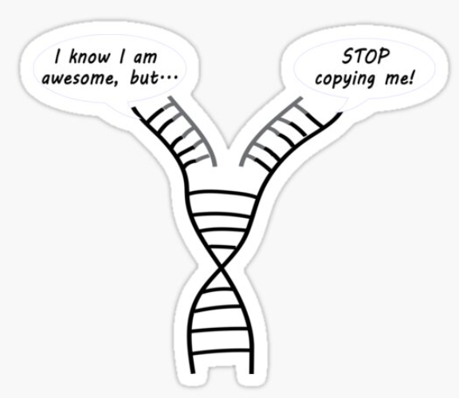
Date: | Human Biology Year 12 ATAR
Do Now Past Exam Question Hand in Review worksheet for checking Lesson Agenda 1: Do Now Activity 2: DNA Sequencing 3: Protein Electrophoresis 4: Lesson summary and wind-up Suggested Study Complete review worksheet, then mark and correct using the answer key on Connect NEXT LESSON Review of Recombinant DNA Technology | Learning Aims Review the structure of DNA Review chemical structure of nucleotides Describe the steps involved in Sanger DNA sequencing Describe the steps involved in gel electrophoresis Discuss uses of DNA sequencing
 | Key Vocabulary Sanger Sequencing dNTP ddNTP / “terminator base” Electrophoresis

Slide 3
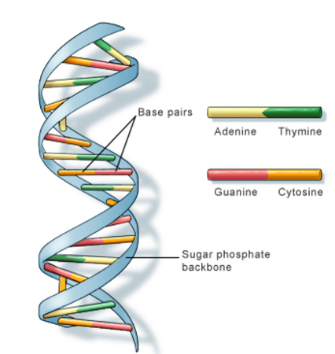
DNA reminder
DNA: Deoxyribonucleic acid
Found in cells of all organisms
Nucleus and mitochondria
Sugar and phosphate backbone
Nitrogen base “rungs”
4 bases:
Adenine (A)
Thymine (T)
Cytosine (C)
Guanine (G)
Order of bases codes for protein production
Learning Aim: Review structure of DNA

Slide 4
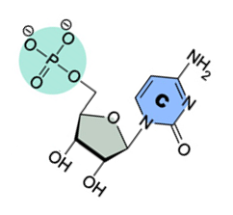
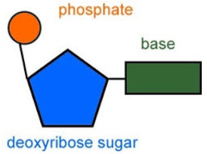
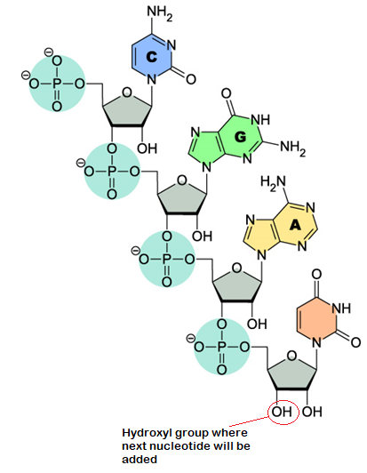
DNA Sequencing
Phosphate + sugar + base = nucleotide
During DNA sequencing, DNA polymerase assists in adding nucleotides to a template strand
As each nucleotide is added, it bonds to the next at the hydroxyl group in the sugar/phosphate backbone. This is an important aspect to remember to understand how the sequencing process works.
DNA sequencing:
Determines order of nucleotide bases
Eg CCTTAGATCTTATGCCC…..
Technique most often used invented by Frederick Sanger – won Chemistry Nobel Prize
Learning Aim: Review chemical structure of nucleotides and how they are bonded to the sugar/phosphate backbone.

Slide 5
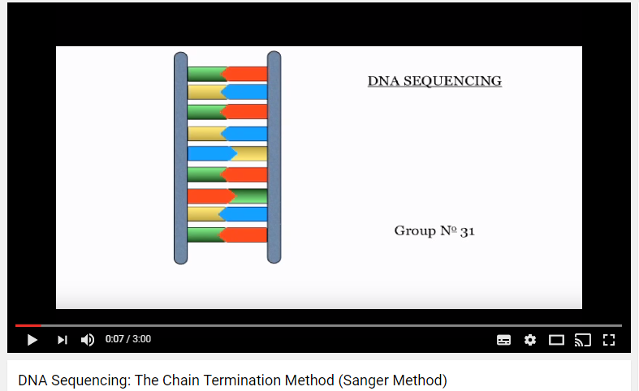
DNA Sequencing: Sanger Technique (aka Chain Termination Method)
See Youtube animation at:
https://www.youtube.com/watch?v=vK-HlMaitnE
Learning Aim: Describe the steps involved in the Sanger sequencing technique

Slide 6
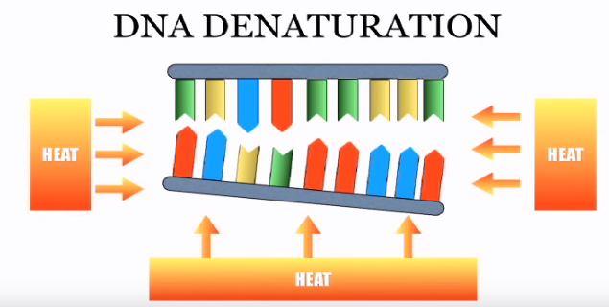
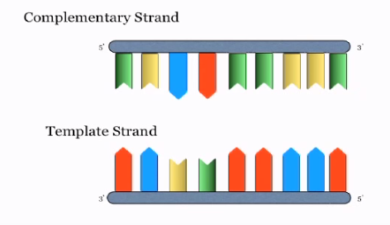
1: DNA is heated so it denatures into single strands:
Template strand will be used:
Learning Aim: Describe the steps involved in the Sanger sequencing technique

Slide 7
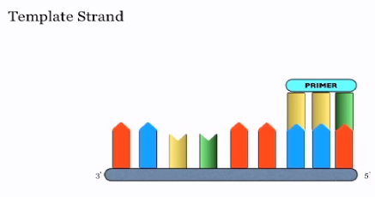
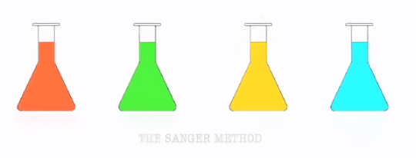
2: Primer is added to the template strand, to provide a starting point for later nucleotide addition.
3: Four reaction mixtures are set up. One will be used for each base type.
Learning Aim: Describe the steps involved in the Sanger sequencing technique

Slide 8
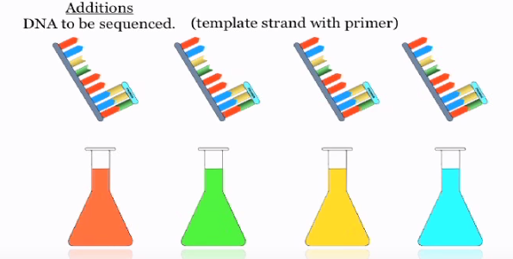
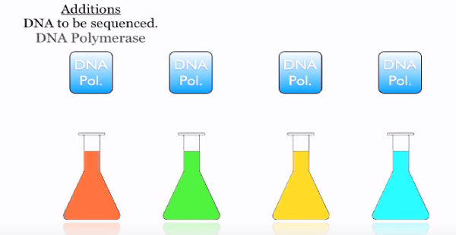
4: Template strand that will be sequenced, with the annealed primer, is added to each reaction mixture. Many copies are added to each mixture
5: DNA polymerase is added. It will allow free nucleotides to be added to the template strand later.
Learning Aim: Describe the steps involved in the Sanger sequencing technique

Slide 9
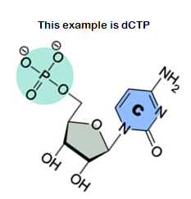
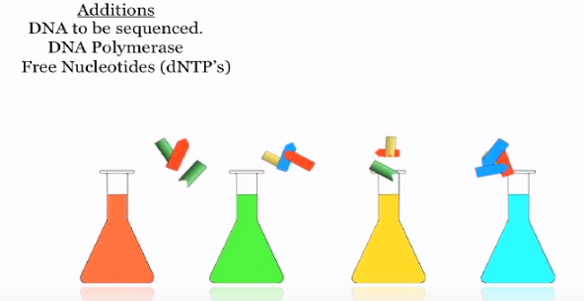
6: Free nucleotides (dNTP’s) of all types added to each reaction mixture and some radioactively labelled for later identification.
Note: dNTP = deoxynucleoside triphosphate
dATP = adenine
dTTP = thymine
dCTP = cytosine
dGTP = guanine
Learning Aim: Describe the steps involved in the Sanger sequencing technique

Slide 10
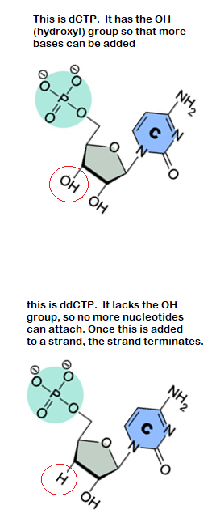
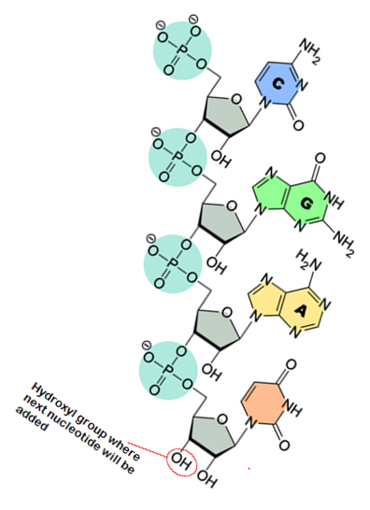
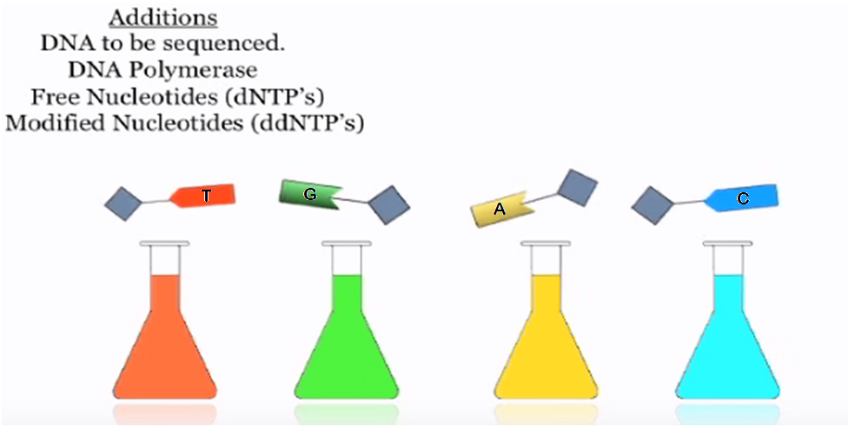
Learning Aim: Describe the steps involved in the Sanger sequencing technique
7: Modified nucleotides (ddNTP’s – dideoxynucleotide triphosphate) added
Only one type is added per reaction mixture
These lack the hydroxyl group, so no more nucleotides can attach
This terminates the chain when it is added to the template strand by the DNA polymerase
This means that in the flask with the T added, the template strands will always terminate with a T. They will be different lengths depending on the point at which the ddTTP gets added. So the flask with the T added will end up with lots of different lengths of copied strand, each starting with the primer and ending with a T.

Slide 11
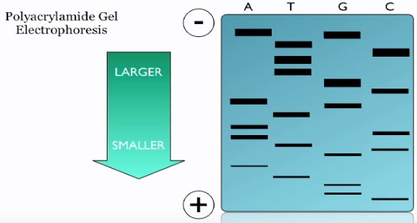
8: Gel electrophoresis used to separate bits of DNA according to size
One reaction mixture per gel lane
A current is run through the gel mixture and the negatively charged DNA strands move towards the positive terminal.
The shortest strands move the fastest
The strands show up as bands on the gel.
Can then determine sequence as we know which modified nucleotide terminates each chain
In this case, reading from smallest to largest, we get the sequence: CGGTAGCTACAT….
Learning Aim: Describe the steps involved in gel electrophoresis

Slide 12
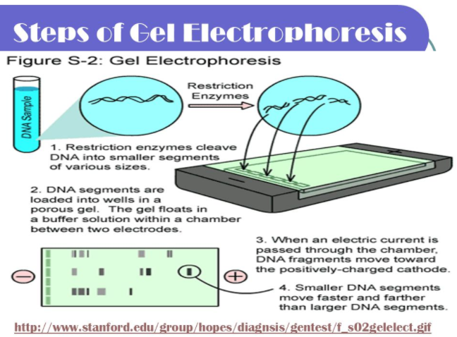
In Sanger Sequencing, it is not restriction enzymes that cut the DNA into segments. It is the ddNTP’s that terminate the sequence at different lengths.
Learning Aim: Describe the steps involved in gel electrophoresis

Slide 13
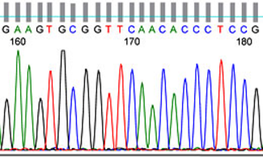
DNA Sequencing: uses
DNA sequencing can be used to:
Compare DNA sequences to detect changed alleles
Readily identify point mutations, small insertions and deletions by comparing.
Track sequences over time to show evolutionary change.
Diseases that can be determined by DNA sequencing:
Sickle-cell anaemia
Cystic fibrosis
Some hereditary forms of cancer
Also used for paternity tests and forensic identification – see profiling techniques.
Learning Aim: Discuss uses of DNA sequencing

Slide 14
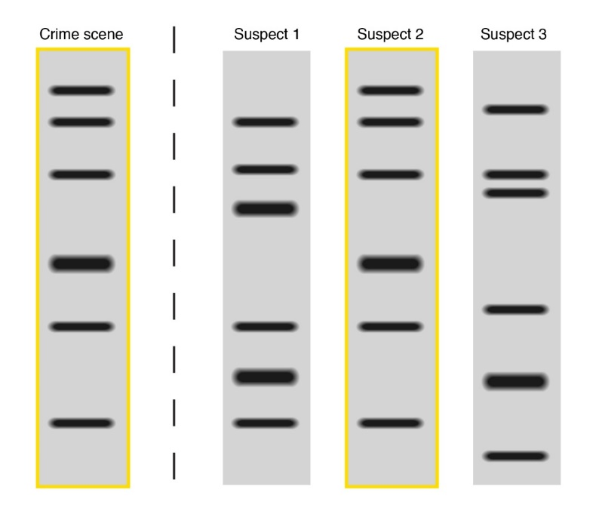
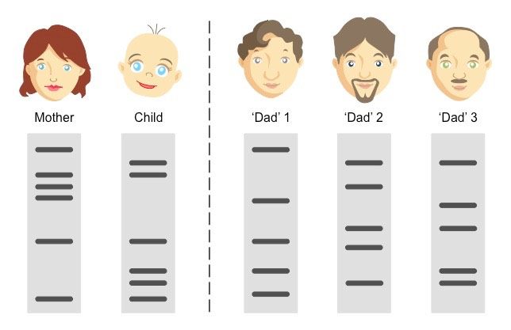
DNA Profiling Techniques
DNA can be used as a means of identification
Specific restriction enzymes cut DNA at specific base sequences, leaving various lengths.
Lengths vary between individuals as base sequences differ between individuals.
Gel electrophoresis can show these differences/similarities to determine if two biological samples come from the same person. “DNA fingerprint”.
Can also be used to determine relatedness between two samples eg paternity testing.
Can also be used to identify particular gene sequences for some diseases.
Learning Aim: Discuss uses of DNA sequencing

Slide 15
Activity: Modelling Sanger Sequencing
Get into groups of 3. Each group will model one of the four reaction mixtures.
Gather your equipment. Each person in the group will need:
The “template strand for the sequence of interest” on paper. You will need lots of these.
A container of “free nucleotides” – counters in different colours.
A pen.
A pair of scissors.
Your teacher will give you a “ddntp terminator base” for the reaction mixture your group is modelling.
3. a. Place a template strand in front of you. Randomly pull a nucleotide from the container, without looking. If it does not bond with the first base after the primer, put it back.
b. Keep pulling nucleotides out until you get one that matches, then write it in the box and put the counter back.
c. Repeat for the nucleotides in sequence until a terminator base is added. Write it in the box, then use the scissors to cut the template strand just after the terminator base. Put the strand aside for later.
Repeat Step 3 with a new template strand, until you run out of time or template strands.
Your teacher will collate the strands for the whole class, and model electrophoresis and reading of the sequence.

